Slide 1
Tutorial 4
Emil Snyman, Peter Nguyen, and Lane Lerner

Slide 2
QIIME2 Overview
Quantitative Insights into Microbial Ecology Version 2 (QIIME2)
Used to translate raw microbiome data (16s rRNA) into statistical analyses
Basic Functions
Data summary visualizations (summary statistics)
Phylogenetic trees
Taxonomic classification
Data filtering
Alpha rarefaction plots
Diversity analyses
Statistical analyses

Slide 3
QIIME2 Diversity Analyses
Alpha Diversity Metrics
Shannon's diversity index
Observed features
Evenness
Faith's Phylogenetic Diversity
Beta Diversity Metrics
Jaccard distance
Bray-Curtis distance
Unweighted UniFrac distance
Weighted UniFrac distance

Slide 4
QIIME2 Statistical Analysis
Longitudinal data analysis
Q2-longitudinal plugin
Visualization using volatility plots
Testing temporal trends for alpha and beta diversities
Linear mixed effects (LME) models
Can account for random effects (clusters)
Volatility visualizations
Interactive line plots that show how volatile a given dependent variable is over a continuous independent variable
Differential abundance testing
Plugins
Q2-songbird
Q2-composition
Types
Analysis of Composition of Microbiomes (ANCOM) - increases Type I and II error potential
Songbird - better for accounting for confounding variables
Notes:
https://www.sciencedirect.com/science/article/pii/S2352304219301217
https://docs.qiime2.org/2022.2/concepts/
https://currentprotocols.onlinelibrary.wiley.com/doi/full/10.1002/cpbi.100

Slide 5
Before Getting Started
First port the QIIME2 container to Picotte
Then get a sample metadata
Finally, need to acquire sequence data

Slide 6
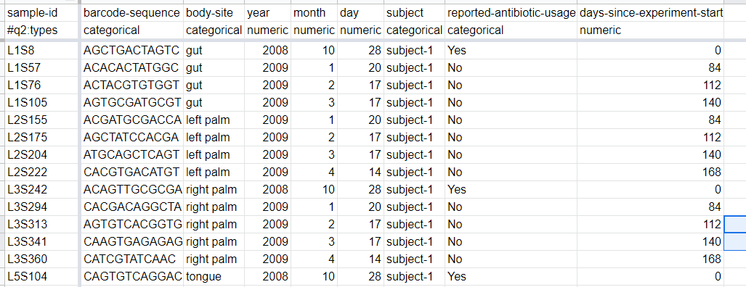
Sample Metadata
Can also be taken from public data
Holds the samples to be used
tab - separated text file
Format:
Sample ID/BarcodeSequence/extra

Slide 7
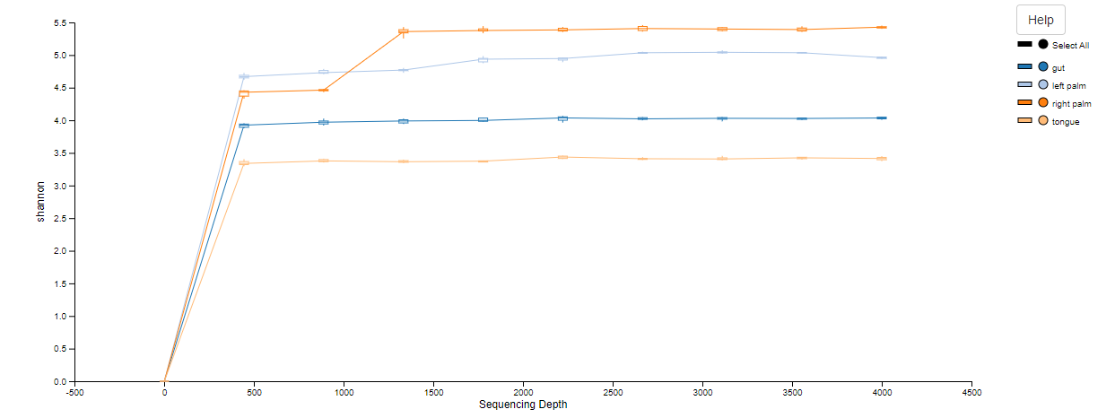
Sequence Data
Can be taken from public data
FASTQ
Using the EMP Protocol Format
Examples:
emp-single-end-sequences/barcodes.fastq.gz
emp-single-end-sequences/sequences.fastq.gz

Slide 8
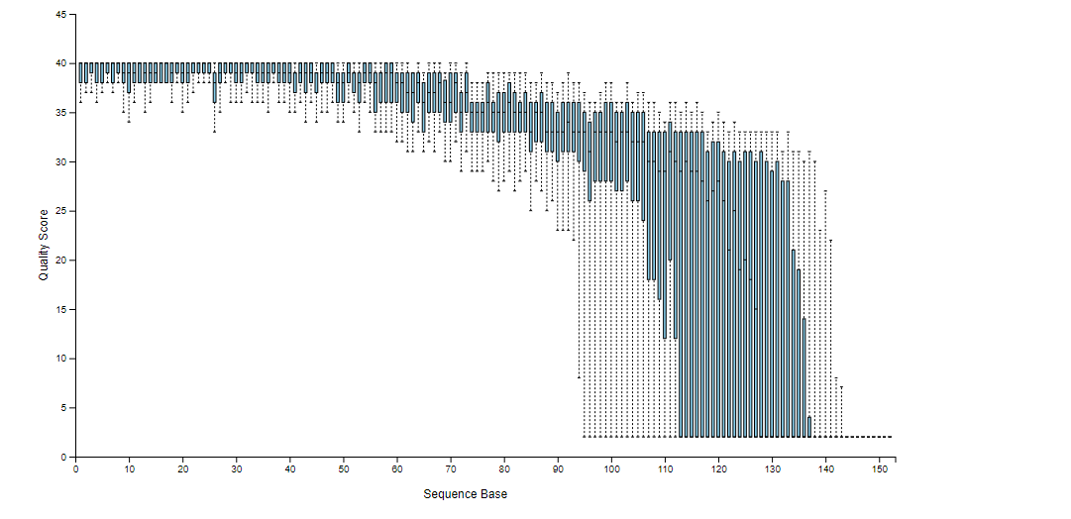
Results - Data Visualization for Sequence Quality

Slide 9
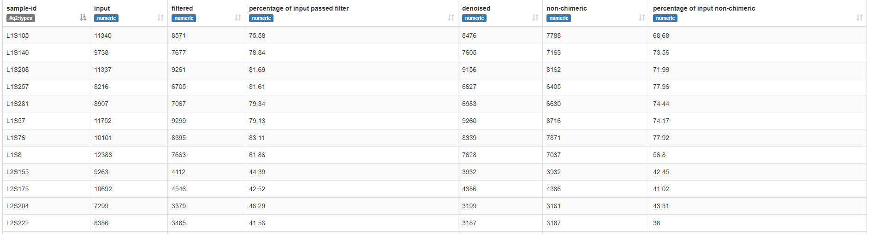
Results - Denoised Sequences

Slide 10
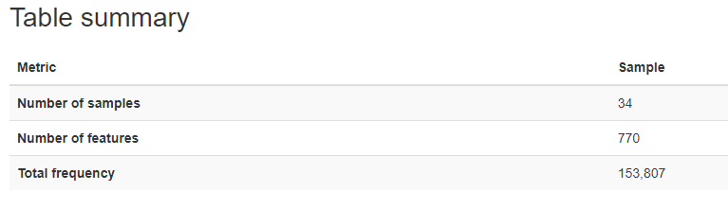
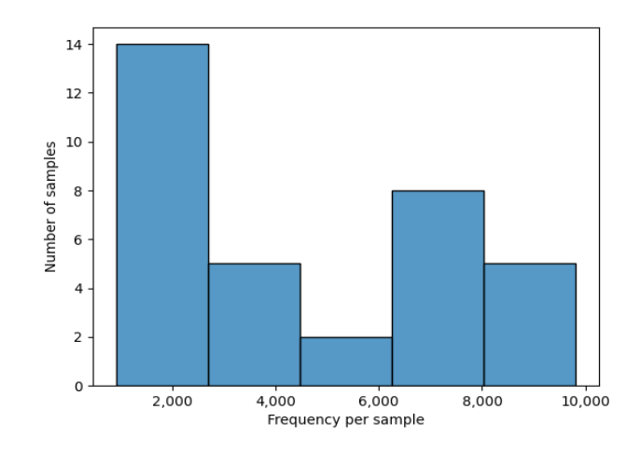
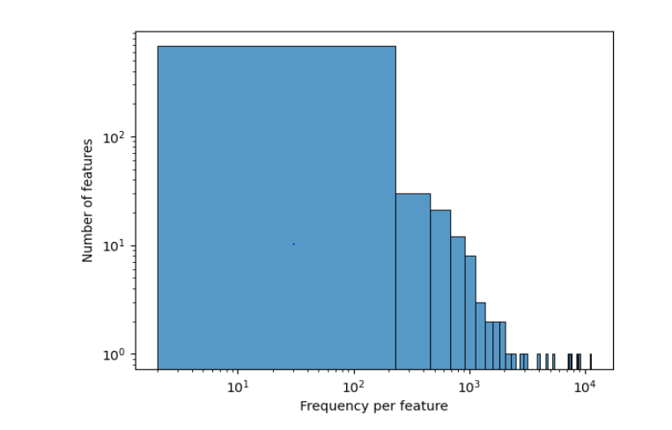
Results - Feature Tables

Slide 11
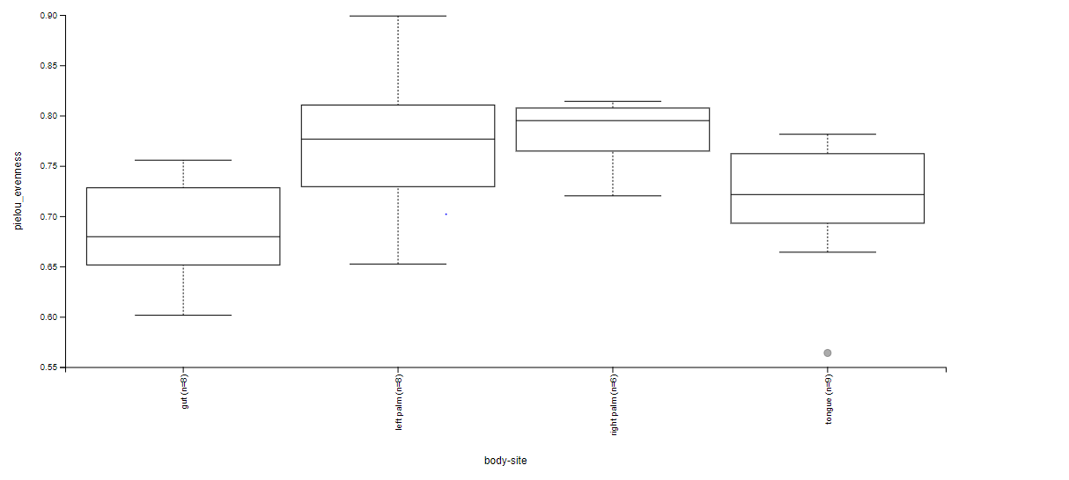
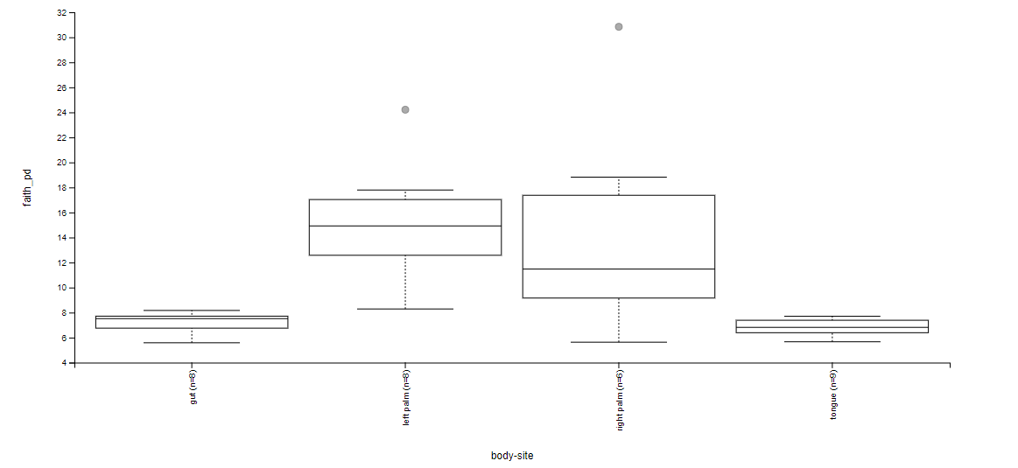
Results - Alpha Diversity Analysis
Evenness Group Significance
Faith pd group Significance

Slide 12
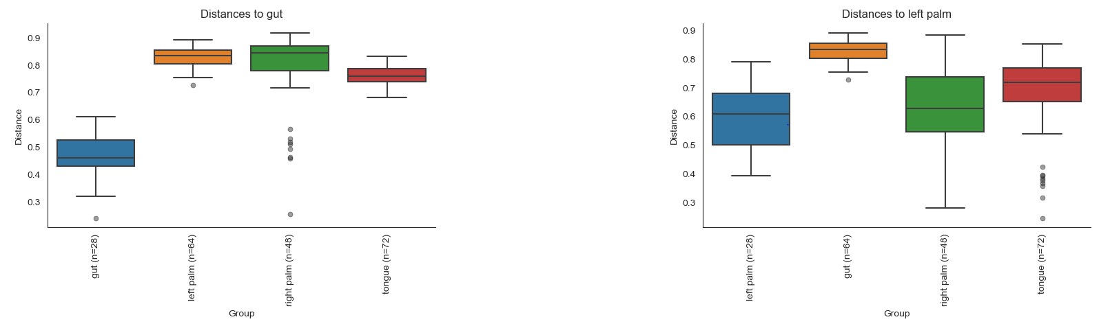
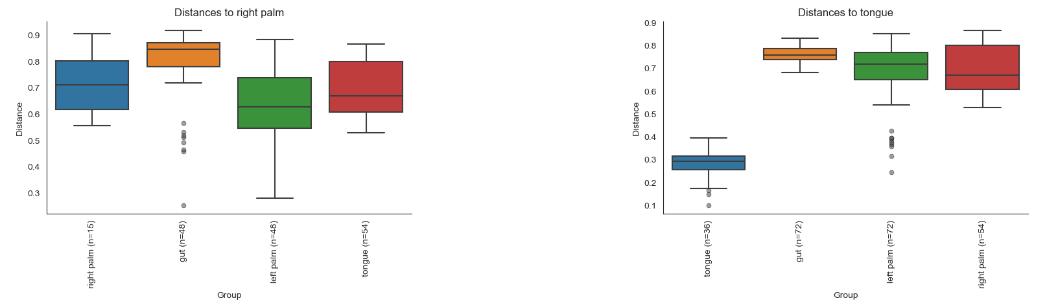
Results - Beta Diversity Analysis
Unifrac Subject Body Significance

Slide 13
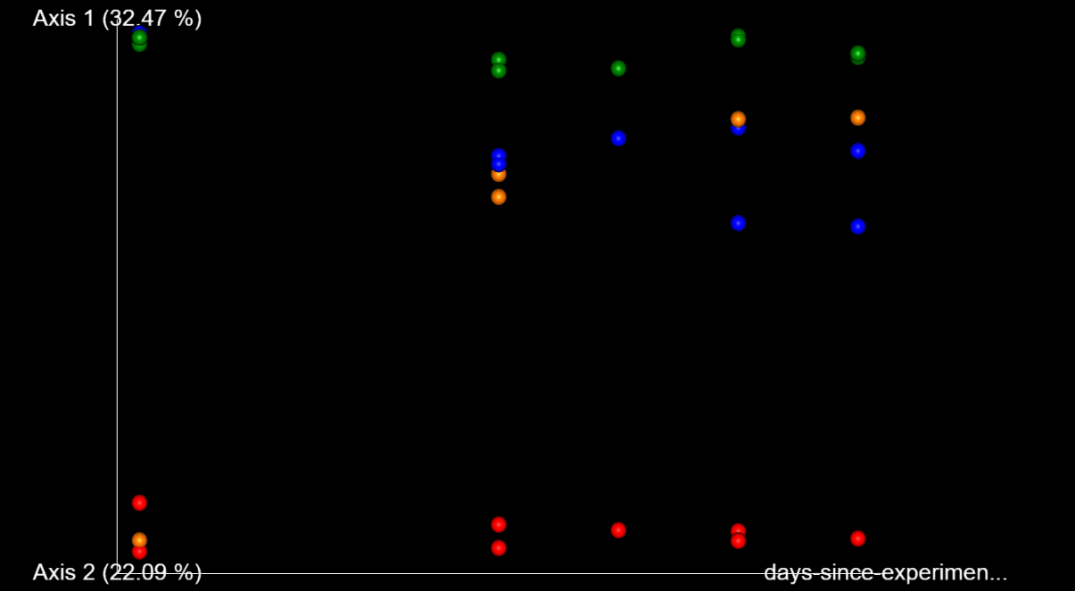
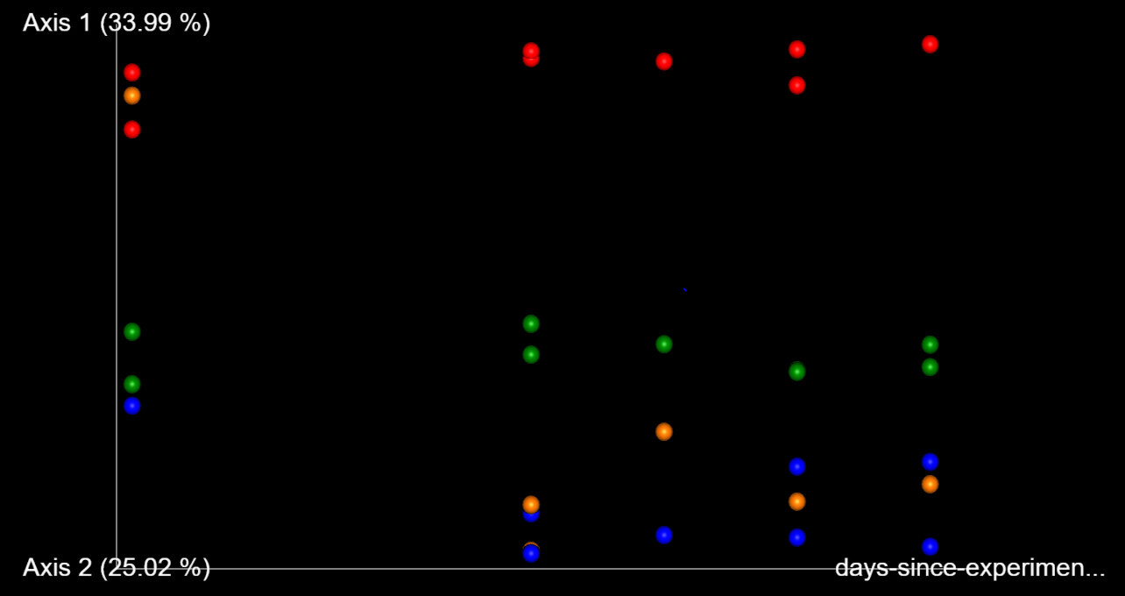
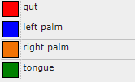
Results - Beta Diversity Analysis
Bray Curtis Emperor Days Since Experiment Start
Unweighted Unifrac Emperor Days Since Experiment Start

Slide 14
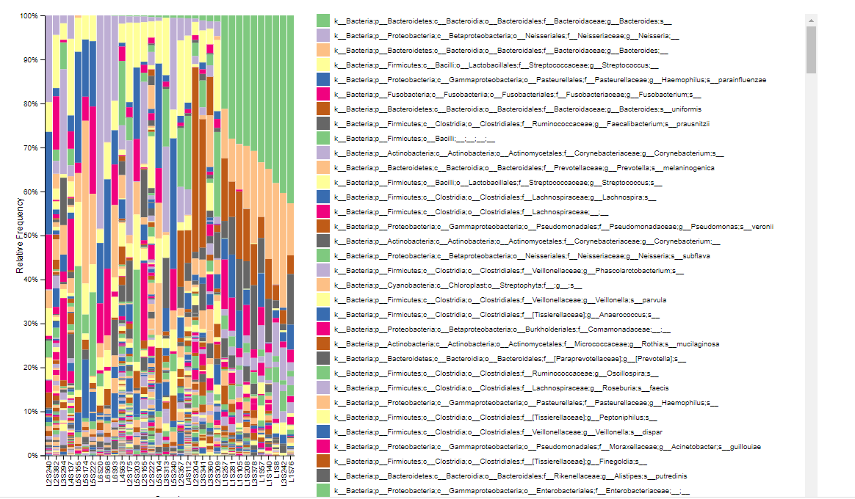
Results - Taxonomic Classifications

Slide 15
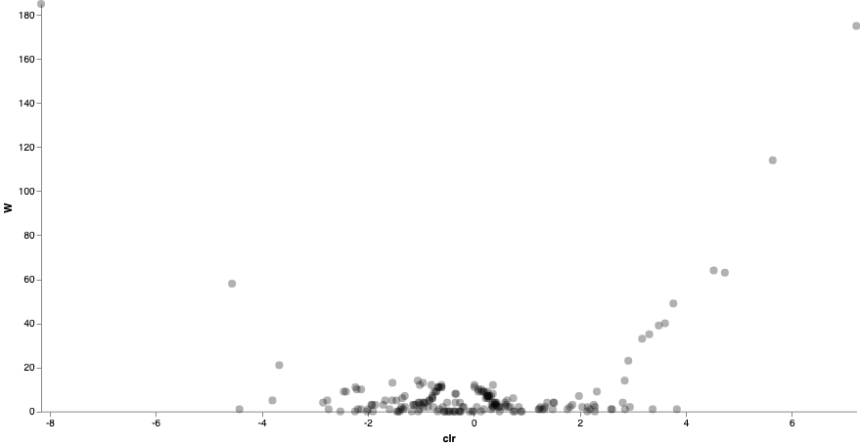
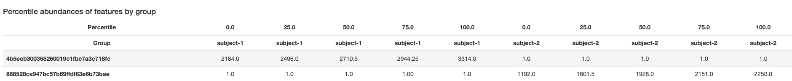
Results - ANCOM Volcano Plot

Slide 16
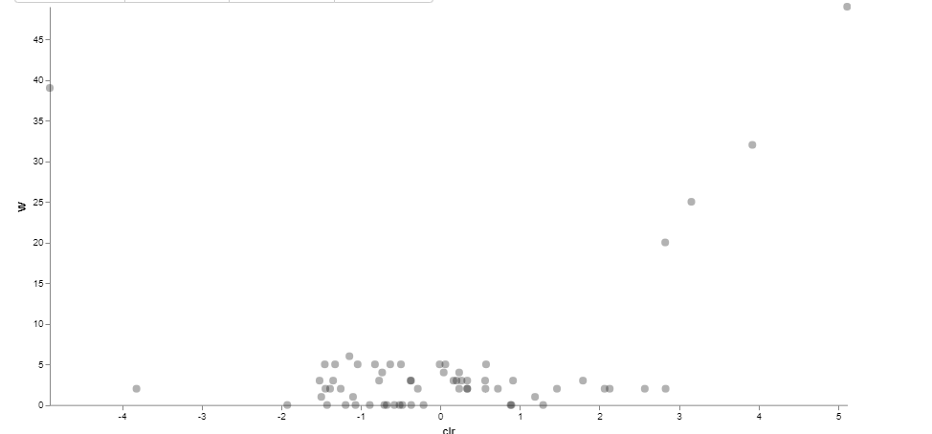
Results - ANCOM level 6 Volcano Plot

Slide 17
Works Cited
Estaki, M., Jiang, L., Bokulich, N. A., McDonald, D., González, A., Kosciolek, T., Martino, C., Zhu, Q., Birmingham, A., Vázquez-Baeza, Y., Dillon, M. R., Bolyen, E., Caporaso, J. G., & Knight, R. (2020). QIIME 2 enables comprehensive end-to-end analysis of diverse microbiome data and comparative studies with publicly available data. Current Protocols in Bioinformatics, 70, e100. doi: 10.1002/cpbi.100
Shesh N. Rai, Chen Qian, Jianmin Pan, Jayesh P. Rai, Ming Song, Juhi Bagaitkar, Michael Merchant, Matthew Cave, Nejat K. Egilmez, Craig J. McClain, Microbiome data analysis with applications to pre-clinical studies using QIIME2: Statistical considerations, Genes & Diseases, Volume 8, Issue 2, 2021, Pages 215-223, ISSN 2352-3042, https://doi.org/10.1016/j.gendis.2019.12.005.
“Core Concepts¶.” QIIME 2 Docs, https://docs.qiime2.org/2022.2/concepts/.
Jimenez R. Practical metagenomics: microbiome tutorial with QIIME 2 [version 1; not peer reviewed]. F1000Research 2021, 10:798 (document) (https://doi.org/10.7490/f1000research.1118734.1)
“Moving Pictures” tutorial. QIIME 2 Docs, https://docs.qiime2.org/2022.2/tutorials/moving-pictures/

